Slide 1
CNN Structure & Filters
Week 7 - Day 1

Slide 2
What Makes CNNs Special for Images?
Traditional neural networks flatten image input → lose spatial structure
CNNs preserve spatial relationships using:
Local connections
Shared weights
Hierarchical learning

Slide 3
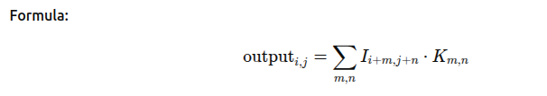
What is a Convolutional Layer?
A filter/kernel slides across the input image
Computes a dot product between filter & image patch
Output = Feature Map

Slide 4
Understanding Filters (Kernels)
Filters are small (e.g., 3x3, 5x5)
Learn to detect edges, textures, or shapes
CNNs learn multiple filters per layer
🧪 Example:
1st layer → edge detectors
3rd layer → object parts (eyes, wheels)

Slide 5
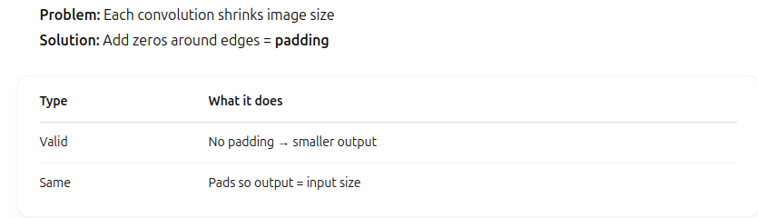
Padding – Keep Output Size Manageable

Slide 6
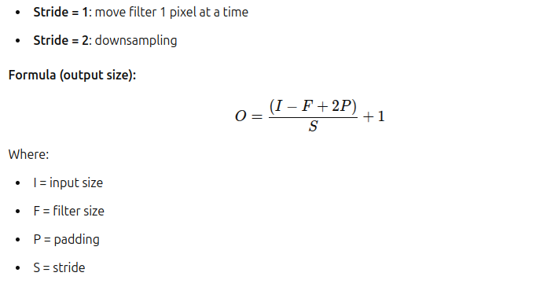
Stride – Control How the Filter Moves

Slide 7
CNN Architecture Overview
Input: Image (e.g., 32x32x3)
Conv Layer + ReLU
Pooling Layer
Repeat…
Flatten
Fully Connected Layer
Output: Class probabilities
🧱 Think of it like feature extraction → classification

Slide 8
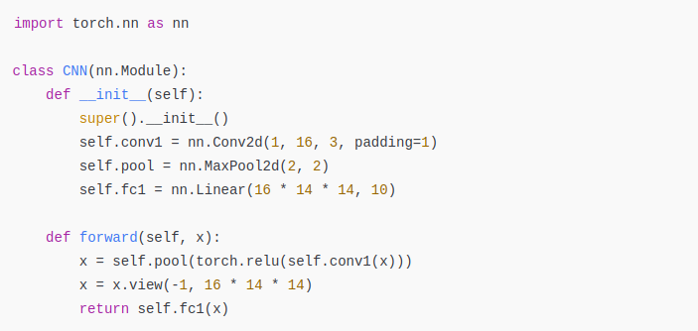
CNN in Code (PyTorch)

Slide 9
Training a CNN on MNIST
MNIST: 28x28 grayscale images of digits (0–9)
Easy dataset for beginner CNNs
Use:
Conv → Pool → ReLU
CrossEntropyLoss
Adam optimizer
Epochs: 5–10 Accuracy Target: 98%+

Slide 10
Visualizing Learned Filters
After training, you can inspect the filters
These show what the network “looks for”
Normalize & display filters (use matplotlib)
Early layers → edge detectors
Deeper layers → abstract shapes

Slide 11

Visualizing Activations
Activations = output of a layer after convolution + ReLU
Help us understand what features the network finds
Visualize each feature map
Helps debug or explain model behavior

Slide 12
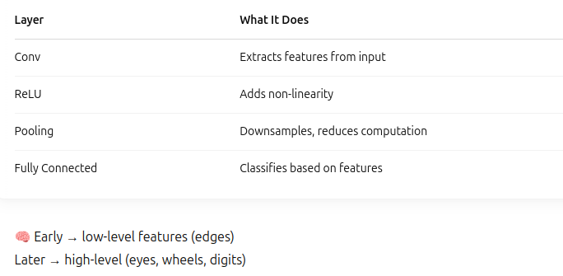
What Happens in Each Layer

Slide 13
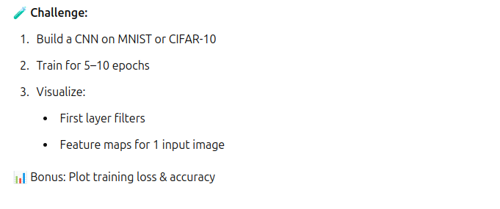
Activity

